Slide 1
NoSQL Databases
Matteo Francia – University of Bologna

Slide 2
About me
Matteo Francia, PhD
Adjunct Professor, will teach Big Data and Cloud Platforms next year
Member of the Business Intelligence Group
Main research interests:
big data
data modeling
precision agriculture
Acknowledgements
Thanks to Enrico Gallinucci for this teaching material

Slide 3
About today
A quick introduction on NoSQL databases
Origins
Characteristics
Data models
Issues
Usage
Demo

Slide 4
Let's start from the beginning

Slide 5
RDBMSs are full of strength
ACID properties
Provides guarantees in terms of consistency and concurrent accesses
Data integration and normalization of schemas
Several application can share and reuse the same information
Standard model and query language
The relational model and SQL are very well-known standards
The same theoretical background is shared by the different implementations
Robustness
Have been used for over 40 years
Notes:
Atomicity - each statement in a transaction (to read, write, update or delete data) is treated as a single unit. Either the entire statement is executed, or none of it is executed. This property prevents data loss and corruption from occurring if, for example, if your streaming data source fails mid-stream.
Consistency - ensures that transactions only make changes to tables in predefined, predictable ways. Transactional consistency ensures that corruption or errors in your data do not create unintended consequences for the integrity of your table.
Isolation - when multiple users are reading and writing from the same table all at once, isolation of their transactions ensures that the concurrent transactions don’t interfere with or affect one another. Each request can occur as though they were occurring one by one, even though they're actually occurring simultaneously.
Durability - ensures that changes to your data made by successfully executed transactions will be saved, even in the event of system failure.

Slide 6
RDBMSs have weaknesses as well
Impedance mismatch
Data are stored according to the relational model, but applications to modify them typically rely on the object-oriented model
Many solutions, no standard
E.g.: Object Oriented DBMS (OODBMS), Object-Relational DBMS (ORDBMS), Object-Relational Mapping (ORM) frameworks
Painful scaling-out
Not suited for a cluster architecture
Distributing an RDBMS is neither easy nor cheap (e.g., Oracle RAC)
Consistency vs latency
Consistency is a must – even at the expense of latency
Today's applications require high reading/writing throughput with low latency
Schema rigidity
Schema evolution is often expensive

Slide 7
What is "NoSQL"
The term has been first used in '98 by Carlo Strozzi
It referred to an open-source RDBMS that used a query language different from SQL
In 2009 it was adopted by a meetup in San Francisco
Goal: discuss open-source projects related to the newest databases from Google and Amazon
Participants: Voldemort, Cassandra, Dynomite, HBase, Hypertable, CouchDB, MongoDB
Today, NoSQL indicates DBMSs adopting a different data model from the relational one
NoSQL = Not Only SQL
According to Strozzi himself, NoREL would have been a more proper noun

Slide 8
The first NoSQL systems
LiveJournal, 2003
Goal: reduce the number of queries on a DB from a pool of web servers
Solution: Memcached, designed to keep queries and results in RAM
Google, 2005
Goal: handle Big Data (web indexing, Maps, Gmail, etc.)
Solution: BigTable, designed for scalability and high performance on Petabytes of data
Amazon, 2007
Goal: ensure availability and reliability of its e-commerce service 24/7
Solution: DynamoDB, characterized by strong simplicity for data storage and manipulation
Notes:
https://en.wikipedia.org/wiki/LiveJournal LiveJournal è una sorta di MSN russo

Slide 9
NoSQL common features
Not just rows and tables
Several data model adopted to store and manipulate data
Freedom from joins
Joins are either not supported or discouraged
Freedom from rigid schemas
Data can be stored or queried without pre-defining a schema (schemaless or soft-schema)
Distributed, shared-nothing architecture
Trivial scalability in a distributed environment with no performance decay
Each workstation uses its own disks and RAM

Slide 10
NoSQL misconceptions
Not a farewell to SQL
Some systems do adopt SQL (or a SQL-like language)
Not necessarily open-source
There exist both open-source and commercial systems
Not only Cloud Computing
There exist both on-premise and cloud solutions
Not an optimization of hardware resources
With the same resources, a centralized RDBMS is probably better performing
Notes:
○ It’s not about a clever use of RAM and SSD—Many NoSQL systems focus on the efficient use of RAM or solid state disks to increase performance. Though this is important, NoSQL systems can run on standard hardware.

Slide 11
Data modeling

Slide 12
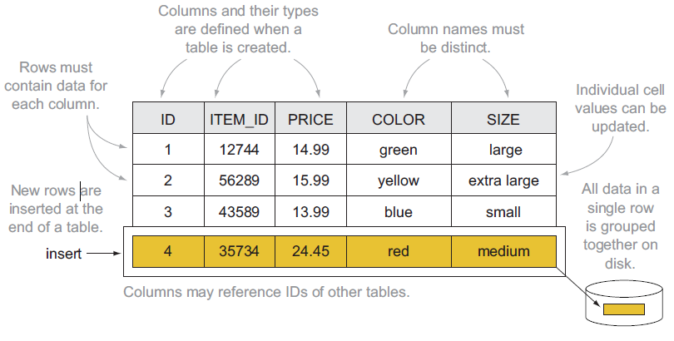
Relational model

Slide 13
NoSQL: several data models
One of the key challenges is to understand which one fits best with the required application
Model | Description | Use cases
Key-value | Associates any kind of value to a string | Dictionary, lookup table, cache, file and images storage
Document | Stores hierarchical data in a tree-like structure | Documents, anything that fits into a hierarchical structure
Wide column | Stores sparse matrixes where a cell is identified by the row and column keys | Crawling, high-variability systems, sparse matrixes
Graph | Stores vertices and arches | Social network queries, inference, pattern matching

Slide 14
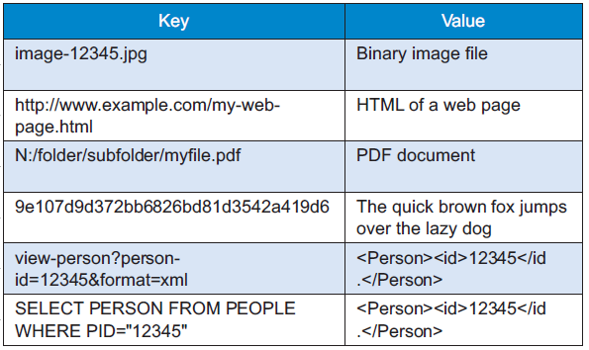
Key-value: data model
Each DB contains one or more collections (corresponding to tables)
Each collection contains a list of key-value pairs
Key: a unique string
E.g.: ids, hashes, paths, queries, REST calls
Value: a BLOB (binary large object)
E.g.: text, documents, web pages, multimedia files
Atomicity level: the key-value pair
Looks like a simple dictionary
The collection is indexed by key
The value may contain several information: one or more definitions, synonyms and antonyms, images, etc.

Slide 15
Key-value: querying
Three simple kinds of query:
put($key as xs:string, $value as item())
Adds a key-value pair to the collection
If the key already exists, the value is replaced
get($key as xs:string) as item()
Returns the value corresponding to the key (if it exists)
delete($key as xs:string)
Deletes the key-value pair
The value is a black box: it cannot be queried!
No "where" clauses
No indexes on the values
Schema information is often indicated in the key
Key | Value
user:1234:name | Matteo
user:1234:age | 33
post:9876:written-by | user:1234
post:9876:title | NoSQL Databases
comment:5050:reply-to | post:9876

Slide 16
Document: data model
Each DB contains one or more collections (corresponding to tables)
Each collection contains a list of documents (usually JSON)
Documents are hierarchically structured
Each document contains a set of fields
The ID is mandatory
Each field corresponds to a key-value pair
Key: unque string in the document
Value: either simple (string, number, boolean) or complex (object, array, BLOB)
A complex field can contain other field
Atomicity level: the document
{
"_id": 1234,
"name": "Matteo",
"age": 33, "address": {
"city": "Ravenna", "postalCode": 48124
},
"contacts": [ {
"type": "office", "contact": "0547-338835"
}, {
"type": "skype", "contact": "mfrancia"
} ]
}

Slide 17
Document: querying
Differently from the key-value, the value is visible by the DBMS
Thus, query languages are quite expressive
Can create indexes on fields
Can filter on the fields
Can return more documents with one query
Can select which fields to project
Can update specific fields
Different implementations, different functionalities
Some enable (possibly materialized) views
Some enable MapReduce queries
Some provide connectors to Big Data tools (e.g., Spark, Hive)
Some provide full-text search capabilities

Slide 18
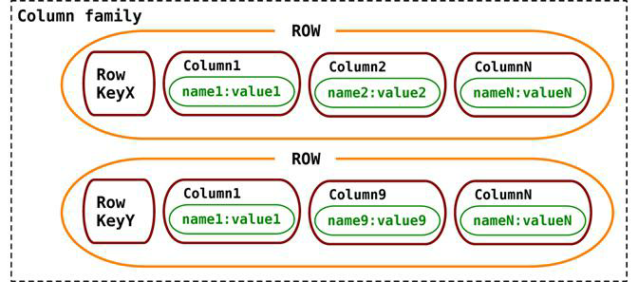
Wide column: data model
Each DB contains one or more column families (corresponding to tables)
Each column family contains a list of row in the form of a key-value pair
Key: unique string in the column family
Value: a set of columns
Each column is a key-value pair itself
Key: unique string in the row
Value: simple or complex (supercolumn)
Atomicity level: the row
With respect to the relational model:
Rows specify only the columns for which a value exists
Particularly suited for sparse matrixes
Timestamps can be used to defines versions of column values
Column family | Row key | Column key | Timestamp | Value

Slide 19
Wide column: querying
The query language expressiveness is in between key-value and document data models
Column indexes are discouraged
Can filter on column values (not always)
Can return more rows with one query
Can select which columns to project
Can update specific columns (not always)
Given the similarity with the relational model, a SQL-like language is often used

Slide 20
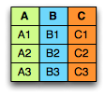
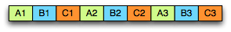
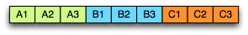
Wide column: ≠ columnar
Do not mistake the wide column data model with the columnar storage used for OLAP applications
Row-oriented
Pro: inserting a record is easy
Con: several unnecessary data may be accessed when reading a record
Column-oriented
Pro: only the required values are accessed
Con: writing a record requires multiple accesses
Row-oriented
Column-oriented

Slide 21
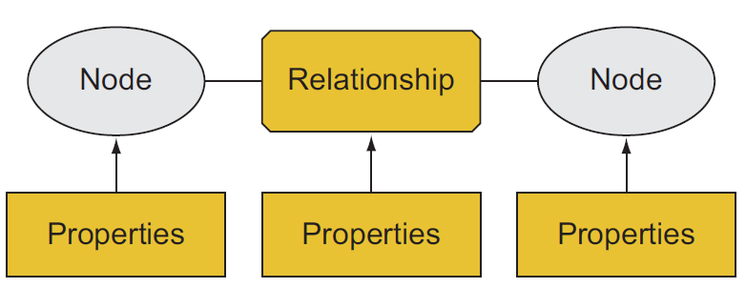
Graph: data model
Each DB contains one or more graphs
Each graph contains vertices and arcs
Vertices: usually represent real-world entities
E.g.: people, organizations, web pages, workstations, cells, books, etc.
Arcs: represent directed relationships between the vertices
E.g.: friendship, work relationship, hyperlink, ethernet links, copyright, etc.
Vertices and arcs are described by properties
Arcs are stored as physical pointers
Atomicity level: the transaction
Most known specializations:
Reticular data model (Parent-child or owner-member relationships)
Triplestore (Subject-predicate-object relationships; e.g., RDF)
Notes:
https://stackoverflow.com/questions/5040617/what-is-the-difference-between-a-graph-database-and-a-network-database

Slide 22
Graph: querying
Graph databases usually model completely different contexts
Thus, query language and mechanism is quite different
Support for transactions
Support for indexes, selections and projections
Query language based on detecting patterns
Query | Pattern
Find friends of friends | (user)-[:KNOWS]-(friend)-[:KNOWS]-(foaf)
Find shortest path from A to B | shortestPath( (userA)-[:KNOWS*..5]-(userB) )
What has been bought by those who bought my same products? | (user)-[:PURCHASED]->(product)<-[:PURCHASED]-()-[:PURCHASED]->(otherProduct)

Slide 23
Aggregate vs Graph modeling
Key-value, document and wide column are called aggregate-oriented
Aggregate = key-value pair, document, row (respectively)
The aggregate is the atomic block (no guarantees for multi-aggregate operations)
Based on the concept of encapsulation
Pro: avoid joins as much as possible → achieve high scalability
Con: data denormalization → potential inconsistencies in the data
Query-driven modeling
The graph data model is intrinsically different from the others
Focused on the relationships rather than on the entities per-se
Limited scalability: it is often impossible to shard a graph on several machines without "cutting" several arcs (i.e. having several cross-machine links)
Batch cross-machine queries: don’t follow relationships one by one, but "group them" to make less requests
Limit the depth of cross-machine node searches
Data-driven modeling
Notes:
https://stackoverflow.com/questions/21558589/neo4j-sharding-aspect
https://ayende.com/blog/4490/that-no-sql-thing-scaling-graph-databases

Slide 24
Data modeling
Let's see some examples

Slide 25
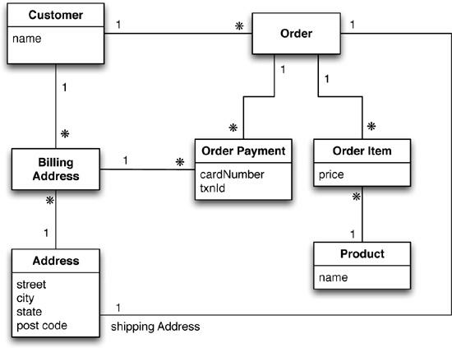
Data modeling
Typical use case: customers, orders and products

Slide 26
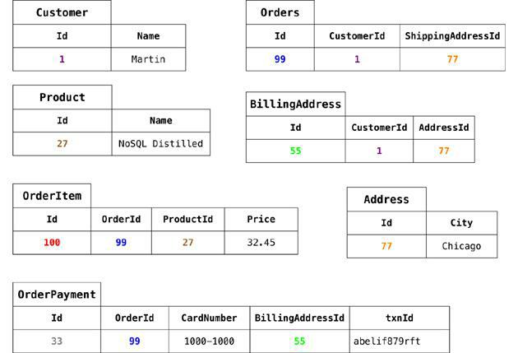
Data modeling: relational

Slide 27
Data modeling: graph
- IDs are implicit
- Different edge colors imply different edge types
name:Martin
CardN: 457
txnId:….
CardN: 477
txnId:….
price:14,4
price:12,4
street:Adam city:Chicago
state:illinois
code:60007
street:9th city:NewYork
state:NewYork
code:10001
name:Cola
name:Fanta

Slide 28
Data modeling: aggregate-oriented

Slide 29
Data modeling: aggregate-oriented

Slide 30
Data modeling: key-value
Customer collection
Product collection
key | value
cust-1:name | Martin
cust-1:adrs | [ {"street":"Adam", "city":"Chicago", "state":"Illinois", "code":60007}, {"street":"9th", "city":"NewYork", "state":"NewYork", "code":10001} ]
cust-1:ord-99 | { "orderpayments": [ {"card":477, "billadrs": {"street":"Adam", "city":"Chicago", "state":"illinois", "code":60007} }, {"card":457, "billadrs": {"street":"9th", "city":"NewYork", "state":"NewYork", "code":10001} ], "products": [ {"id":1, "name":"Cola", "price":12.4}, {"id":2, "name":"Fanta", "price":14.4} ], "shipAdrs": {"street":"9th", "city":"NewYork", "state":"NewYork", code":10001} }
key | value
p-1:name | Cola
p-2:name | Fanta

Slide 31
Data modeling: document-based
Customer collection
Product collection
{
"_id": 1,
"name": "Martin",
"adrs": [
{"street":"Adam", "city":"Chicago", "state":"illinois", "code":60007}, {"street":"9th", "city":"NewYork", "state":"NewYork", "code":10001}
],
"orders": [ {
"orderpayments":[
{"card":477, "billadrs": {"street":"Adam", "city":"Chicago", "state":"illinois", "code":60007}},
{"card":457, "billadrs": {"street":"9th", "city":"NewYork", "state":"NewYork", "code":10001}}
],
"products":[
{"id":1, "name":"Cola", "price":12.4},
{"id":2, "name":"Fanta", "price":14.4}
],
"shipAdrs": {"street":"9th", "city":"NewYork", "state":"NewYork", "code":10001}
}]
}
{
"_id":1,
"name":"Cola",
"price":12.4
}
{
"_id":1,
"name":"Fanta",
"price":14.4
}

Slide 32
Data modeling: document-based
{
"_id": 1,
"name": "Martin",
"adrs": [
{"street":"Adam", "city":"Chicago", "state":"illinois", "code":60007}, {"street":"9th", "city":"NewYork", "state":"NewYork", "code":10001}
]
}
Customer
collection
{
"_id":1,
"name":"Cola",
"price":12.4
}
{
"_id":1,
"name":"Fanta",
"price":14.4
}
Product
collection
{
"_id": 1,
"customer":1,
"orderpayments":[
{"card":477, "billadrs":{"street":"Adam", "city":"Chicago", "state":"illinois", "code":60007}},
{"card":457, "billadrs":{"street":"9th", "city":"NewYork", "state":"NewYork", "code":10001}}
],
"products": [
{"id":1, "name":"Cola", "price":12.4},
{"id":2, "name":"Fanta", "price":14.4}
],
"shipAdrs": {"street":"9th", "city":"NewYork", "state":"NewYork", "code":10001}
}
Order
collection

Slide 33
Data modeling: wide-column
Order details column family
Ord | CustName | Pepsi | Cola | Fanta | …
1 | Martin |  | 12.4 | 14.4
2 | … | … |  |  | …
Order payments column family
Ord | OrderPayments
1
2 | …
Card | Steet | City | State | Code
477 | 9th | NewYork | NewYork | 10001
457 | Adam | Chicago | Illinois | 60007

Slide 34
Summary
The aggregate term comes from Domain-Driven Design
An aggregate is a group of tightly coupled objects to be handled as a block
Aggregates are the basic unit for data manipulation and consistency management
Advantages
Can be distributed trivially (group the data that are used altogether)
Facilitate the developer's job (by surpassing the impedance mismatch problem)
Disadvantages
No real design strategy exists for aggregates
It mainly depends on how data are meant to be used
Can optimize only a limited set of queries
Data denormalization → possible inconsistencies
A data-driven approach is agnostic to how the data is used (mostly)

Slide 35
Dealing with data consistency
In short

Slide 36
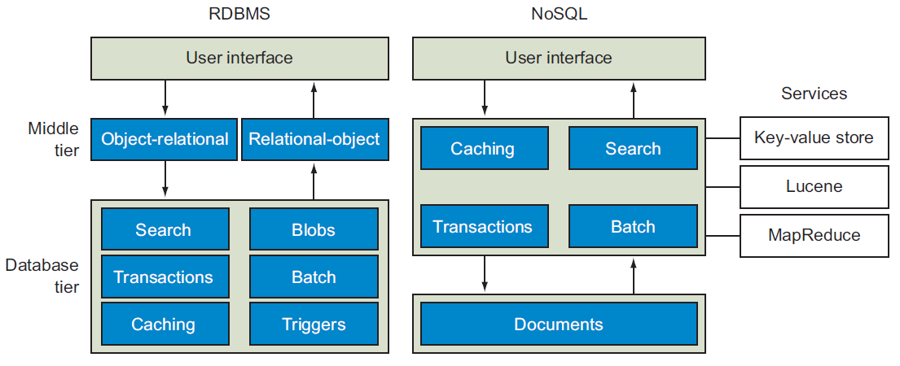
RDBMS vs NoSQL: different philosophies

Slide 37
Consistency: an example
Consider 1000€ to be transferred from bank account A to B; the transfer is made by:
Removing 1000€ from A
Adding 1000€ to B
What should never happen
The money is removed from A but not added to B
The money is added twice to B
A query on the database shows an intermediate state
E.g., A+B = 0€
RDBMS adopt transactions to avoid this kind of issue

Slide 38
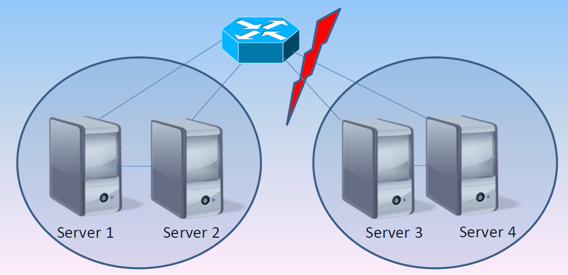
Consistency in NoSQL: CAP
"Theorem": only two of the following three properties can be guaranteed
Consistency: the system is always consistent
Every node returns the same, most recent, successful write
Every client has the same view of the data
Availability: the system is always available
Every non-failing node returns a response for all read and write requests in a reasonable amount of time
Partition tolerance: the system continues to function and upholds its consistency guarantees in spite of network partitions
In distributed systems, network partitioning is an inevitable possibility
Notes:
CAP demonstration: https://dl.acm.org/doi/pdf/10.1145/564585.564601?casa_token=m69maazxkqIAAAAA:cBn5y1eKnJUh7Tl4GVsw9Hqv984qwQ3_b8XvSM_wM3U2zp_-363uPINWJADEmMt-8ZjPzA1yaoE

Slide 39
Consistency in NoSQL: CAP
Three situations
CA: the system cannot suffer from network partitioning (single server)
AP: in case of partitioning, the system sacrifices consistency (overbooking)
CP: in case of partitioning, the system sacrifices availability (bookings prevented)
Theorem interpretation is not trivial
Asymmetric properties: consistency is sacrificed to favor speed at all times, not just when partitioning happens
Different application requirements → different algorithms handle these properties more strictly/loosely

Slide 40
Consistency in NoSQL: CAP relaxed
Consider two users that want to book the same room when a network partition happens
CP: no one can book (A is sacrificed)
Not the best solution
AP: both can book (C is sacrificed)
Possible overbooking: writing conflict to handle
caP: only one can book
The other will se the room available but cannot book it
This is admissible only in certain scenarios
Finance? Blogs? E-commerce?
It’s important to understand:
What is the tolerance to obsolete reads
How large can the inconsistency window be
Notes:
Gestione del conflitto in scrittura:
Last one wins (vince l’ultimo che arriva)
Segnalazione all’utente del conflitto
Quorum

Slide 41
Consistency in NoSQL: summary
NoSQL databases rely on the eventual consistency principle
Trade absolute consistency for latency
Inconsistencies are tolerated within short time windows
Still, unrecoverable inconsistencies may arise
Because of data denormalization
Because of the absence of transaction

Slide 42
One size does not fit all

Slide 43
Key-Value: popular DBs
Redis (Data Structure server): http://redis.io/
Supports complex fields (list, set, …) and operations on values (range, diff, …)
Memcached DB: http://memcached.org/
Riak: http://basho.com/riak/

Slide 44
Key-Value: when to use
Very simple use cases
Independent data (no need to model relationships)
The typical query is a simple lookup
Need super-fast performance
Examples
Session information
Each web session is identified by its own sessionId: All related data can be stored with a PUT request and returned with a GET request.
User profiles, preferences
Each user is uniquely identified (userId, username) and has her own preferences in terms of language, colors, timezone, products, etc. – data that fits well within an aggregate
Shopping cart, chat services
Each e-commerce websites associates a shopping cart to a user; it can be stored as an aggregate identified by the user ID.
Notes:
1 RDBMS would be overkill

Slide 45
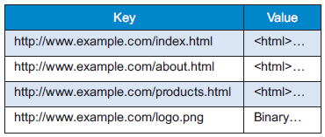
Key-Value: real use cases
Crawling of web pages
The URL is the key, the whole page content (HTML, CSS, JS, images, ..) is the value
Twitter timeline
The user ID is the key, the list of most recent tweets to be shown is the value
Amazon S3 (Simple Storage Service)
A cloud-based file system service
Useful for personal backups, file sharing, website or apps publication
The more you store, the more you pay
Storage: approx. $0.03 per GB per month
Uploading files: approx. $0.005 per 1000 items
Downloading files: approx. $0.004 per 10,000 files* PLUS $0.09 per GB (first GB free)
Notes:
1 RDBMS would be overkill
https://www.infoq.com/presentations/Real-Time-Delivery-Twitter
http://highscalability.com/blog/2014/9/8/how-twitter-uses-redis-to-scale-105tb-ram-39mm-qps-10000-ins.html
https://www.quora.com/Why-is-Twitter-not-using-NoSQL

Slide 46
Key-Value: when to avoid
Data with many relationships
When relationships between data (in the same or in different collections) must be followed
Some systems offer limited link-walking mechanisms
Multi-record operations
Because operations (mostly) involve one record at a time
Querying the data
If it is necessary to query the values, not just the key
Few systems offer limited functionalities (e.g., Riak Search)

Slide 47
Document: popular DBs
MongoDB: http://www.mongodb.org
Couchbase: http://www.couchbase.com
CouchDB: http://couchdb.apache.org

Slide 48
Document: when to use
Higher expressiveness
Store data according to a highly nested data model
Need to formulate complex queries on many fields
Examples
Event logs
Central repo to store event logs from many applications; shard on app name or event type
CMS, blogging platforms
The absence of a predefined schema fits well within content management systems (CMS) or website management applications, to handle comments, registrations and user profiles
Web Analytics or Real-Time Analytics
The ability to update only specific fields enables fast update of analytical metrics
Text indexing enables real-time sentiment analysis and social media monitoring
E-commerce applications
Schema flexibility is often required to store products and orders, as well as to enable schema evolution without incurring into refactoring or migration costs

Slide 49
Document: real use cases
Advertising services
MongoDB was born as a system for banner ads
24/7 availability and high performance
Complex rules to find the right banner based on user’s interests
Handle several kinds of ads and show detailed analytics
Internet of Things
Real-time management of sensor-based data
Bosch uses MongoDB to capture data from cars (breaks, ABS, windscreen wiper, etc.) and aircrafts maintenance tools
Business rules are applied to warn the pilot when the breaking system pressure falls under a critical threshold, or the maintenance operator when the tool is used improperly
Technogym uses MongoDB to capture data from gym equipment

Slide 50
Document: when to avoid
ACID transactions requirement
If not for a few exceptions (e.g., RavenDB), document databases are not suited for cross-document atomicity
Queries on high-variety data
If the aggregate structure continuously evolves, queries must be constantly updated (and normalization clashes with the concept of aggregate)

Slide 51
Wide column: popular DBs
Cassandra: http://cassandra.apache.org
HBase: https://hbase.apache.org
Google BigTable: https://cloud.google.com/bigtable

Slide 52
Wide column: when to use
Compromise between expressiveness and simplicity
Limited (but some) requirements in terms of data model
Limited (but some) requirements in terms of querying records
Examples
Event logs; CMS, blogging platforms
Similarly to document databases, different applications may use different columns
Sparse matrixed
While an RDBMS would store null values, a wide column stores only the columns for which a value is specified
GIS applications
Pieces of a map (tiles) can be stored as couples of latitude and longitude

Slide 53
Wide column: real use cases
Google applications
BigTable is the DB used by Google for most of its applications, including Search, Analytics, Maps and Gmail
User profiles and preferences
Spotify uses Cassandra to store metadata about users, artists, songs, playlists, etc.
Notes:
Netflix: 12M trans/sec. Ebay, >100TB. IoT
https://labs.spotify.com/2015/01/09/personalization-at-spotify-using-cassandra/
https://academy.datastax.com/resources/ds220-data-modeling?unit=use-cases-use-case-introduction

Slide 54
Wide column: when to avoid
Same as for document model
ACID transactions requirement
Queries on high-variety data
Need for full query expressiveness
Joins are usually not supported
Limited support for filters and group bys
Notes:
Prototipazioni: nelle prima fasi di progetto, i pattern delle query possono cambiare frequentemente, con la conseguenza di dover riprogettare le famiglie di colonne. In Cassandra, the cost may be higher for query change as compared to schema change.

Slide 55
Graph: popular DBs
Neo4J: http://neo4j.com
TigerGraph: https://www.tigergraph.com/

Slide 56
Graph: when to use
Interlinked data
Social networks are one of the most typical use case of graph databases (e.g., to store friendships or work relationships); every relationship-centric domain is a good one
Routing and location-based services
Applications working on the TSP (Travelling Salesman Problem) problem
Location-based application that, for instance, recommend the best restaurant nearby; in this case, relationships model the distance between node
Recommendation applications, fraud-detection
Systems recommending «the products bought by your friends», or «the products bought by those who bought your same products»
When relationships model behaviors, outlier detection may be useful to identify frauds

Slide 57
Graph: real use cases
Relationships analysis
Finding common friends (e.g., friend-of-a-friend) in a social network
Identifying clusters of phone calls that identify a criminal network
Analyzing flows of money to identifying money recycling patterns or credit card theft
Main users: law firms, police, intelligence agencies
https://neo4j.com/use-cases/fraud-detection/
Useful for text analysis as well (Natural Language Processing)
Inference
Creating rules that define new knowledge based on existing patterns (e.g., transitive relationships, trust mechanisms)
Notes:
https://developer.ibm.com/dwblog/2017/detecting-complex-fraud-real-time-graph-databases/

Slide 58
Graph: when to avoid
Data-intensive applications
Traversing the graph is trivial, but analyzing the whole graph ca be expensive
There exist framework for distributed graph analysis (e.g., Apache Giraph), but they do not rely on a graph DB

Slide 59
So... are RDBMSs dead?

Slide 60
No! Polyglot persistence
Different databases are designed to solve different problems
Using a single DBMS to handle everything (the one size fits all)…
Operational data
Temporary session information
Graph traversing
OLAP analyses
…
… usually lead to inefficient solutions
Each activity has its own requirements (availability, consistency, fault tolerance, etc.)
Notes:
Termine derivato da "programmazione poliglotta"

Slide 61
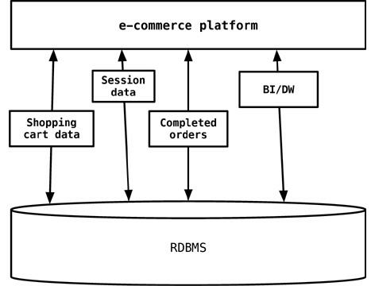
One size fits all approach
Notes:
The session, shopping cart, or order data do not need the same properties of availability, consistency, or backup requirements. Does session management storage need the same rigorous backup/recovery strategy as the e-commerce orders data? Does the session management storage need more availability of an instance of database engine to write/read session data?
In 2006, Neal Ford coined the term polyglot programming, to express the idea that applications should be written in a mix of languages to take advantage of the fact that different languages are suitable for tackling different problems. Complex applications combine different types of problems, so picking the right language for each job may be more productive than trying to fit all aspects into a single language.

Slide 62
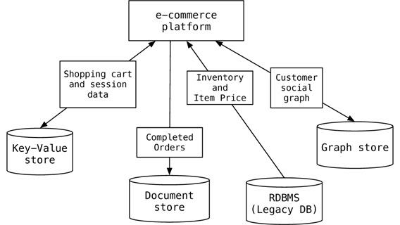
Polyglot data management
Beware: this leads to harder cross-database consistency management
Notes:
A key-value data store could be used to store the shopping cart data before the order is confirmed by the customer and also store the session data so that the RDBMS is not used for this transient data. Key-value stores make sense here since the shopping cart is usually accessed by user ID and, once confirmed and paid by the customer, can be saved in the RDBMS. Similarly, session data is keyed by the session ID. If we need to recommend products to customers when they place products into their shopping carts—for example, “ your friends also bought these products” or “ your friends bought these accessories for this product”—then introducing a graph data store in the mix becomes relevant.
Even using specialized relational databases for different purposes, such as data warehousing appliances or analytics appliances within the same application, can be viewed as polyglot persistence

Slide 63
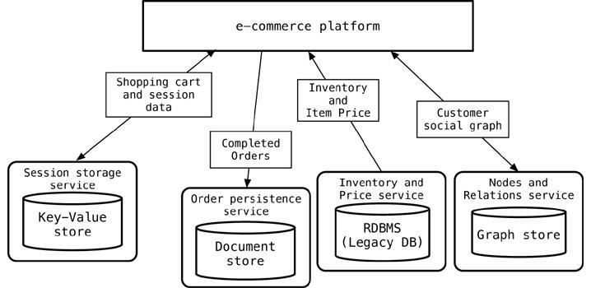
Polyglot data management
Each DB should be "embedded" within services
Data access and manipulation enabled with API services

Slide 64
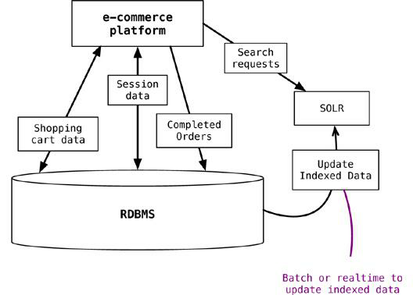
Supporting existing technologies
If the current solution cannot be changed, NoSQL systems can still support the existing ones
Notes:
While doing this, we need to update the indexed data as the data in the application database changes. The process of updating the data can be real-time or batch, as long as we ensure that the application can deal with stale data in the index/search engine. The event sourcing (“ Event Sourcing,” p. 142) pattern can be used to update the index.

Slide 65
Beyond NoSQL
NewSQL systems
Combine the benefits from both relational and NoSQL worlds
Ensure scalability without compromising consistency…
…but by compromising some availability!
Multi-model systems
Support multiple data models
The barrier between distributed and centralized DBMSs still remains
Database-as-a-service
All cloud providers offer storage services supporting all data models

Slide 66
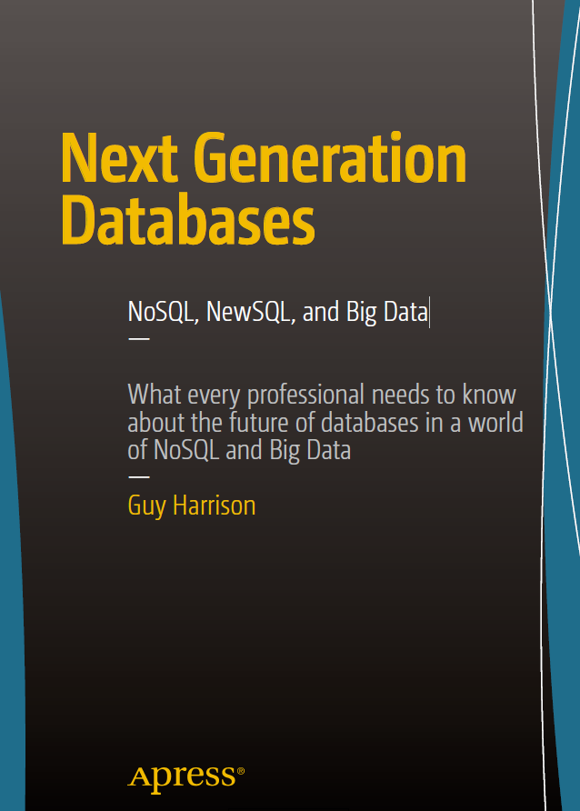
NoSQL Databases
Complementary to RDBMSs
Different data models
Better scaling
Trade absolute consistency for latency
NewSQL and multi-model systems also exist
Want to know more?
← Suggested readings
Distributed algorithms in NoSQL databases
Email me at m.francia@unibo.it
See you next year!

